Slide 1

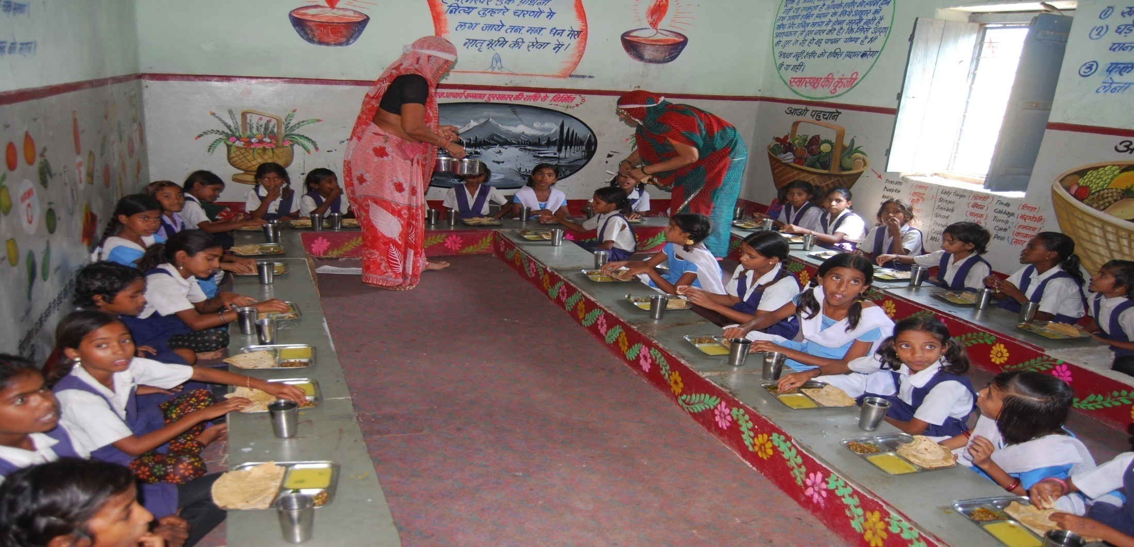
Mid Day Meal Scheme
Government of Madhya Pradesh
Government of Madhya Pradesh
Panchayat & Rural Development Department

Slide 2
Plan Approved
Government of Madhya Pradesh
Approved by Chairman, State Steering cum Monitoring Committee.

Slide 3
No. of institutions year 2019-20
Government of Madhya Pradesh

Slide 4
Working Days
(April 2019 to Dec. 2019)
Government of Madhya Pradesh

Slide 5
Coverage against Enrollment
(April 2019 to Dec. 2019)
Government of Madhya Pradesh
(In Lakh)

Slide 6
Coverage against PAB approval
(April 2019 to Dec. 2019)
Government of Madhya Pradesh
(In Lakh)

Slide 7

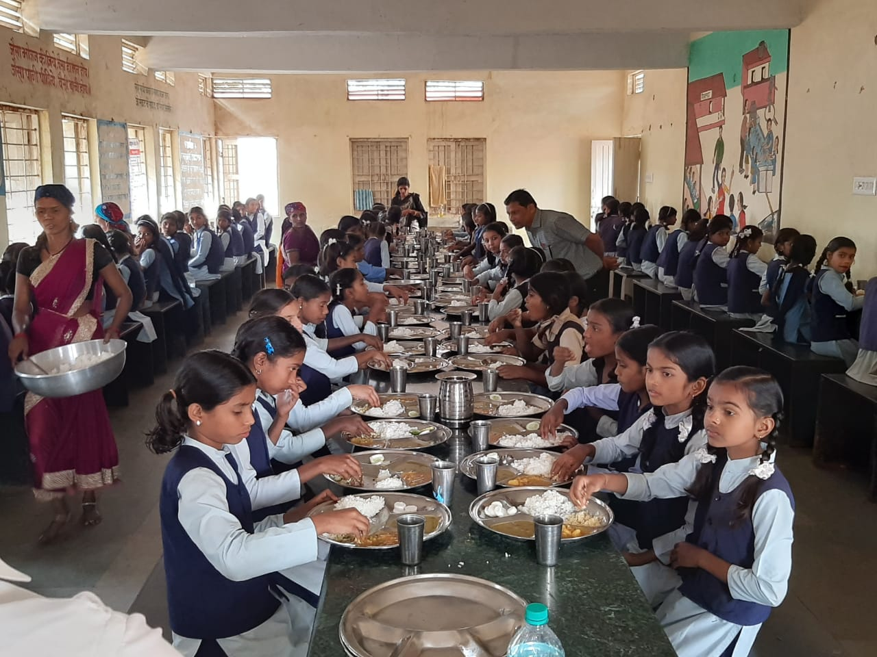
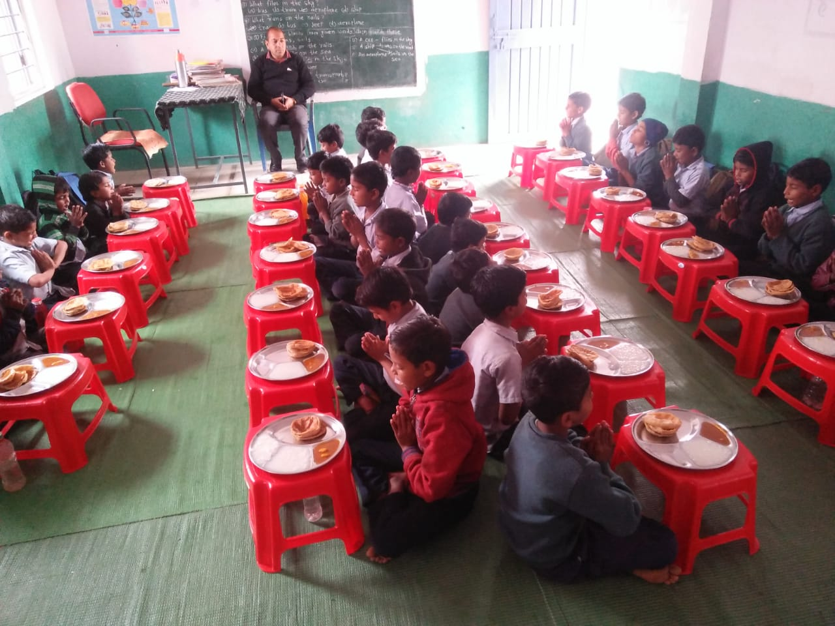
Serving MDM
Government of Madhya Pradesh
District -Neemuch

Slide 8
Food Grains Lifting & Utilisation
(April 2019 to Dec. 2019)
Government of Madhya Pradesh
(Qty. In MTs)

Slide 9
Cost of Food Grains
(April 2019 to Dec. 2019)
Government of Madhya Pradesh
(In Cr)

Slide 10
Cooking Cost Utilisation
(April 2019 to Dec. 2019)
Government of Madhya Pradesh
(In Cr)

Slide 11
CCH – Engagement
(April 2019 to Dec. 2019)
Government of Madhya Pradesh

Slide 12
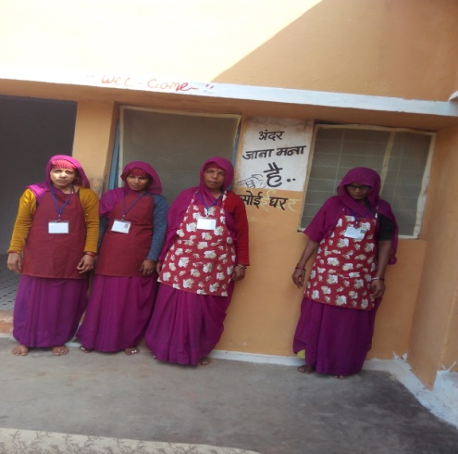
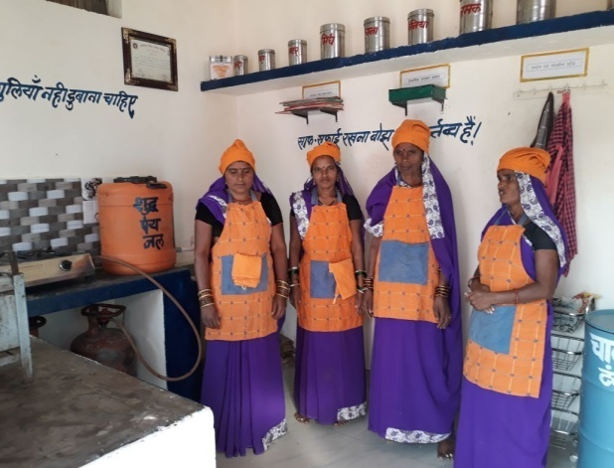
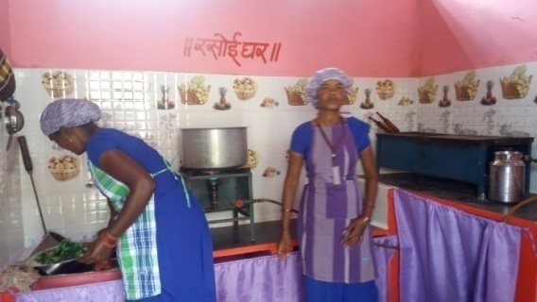
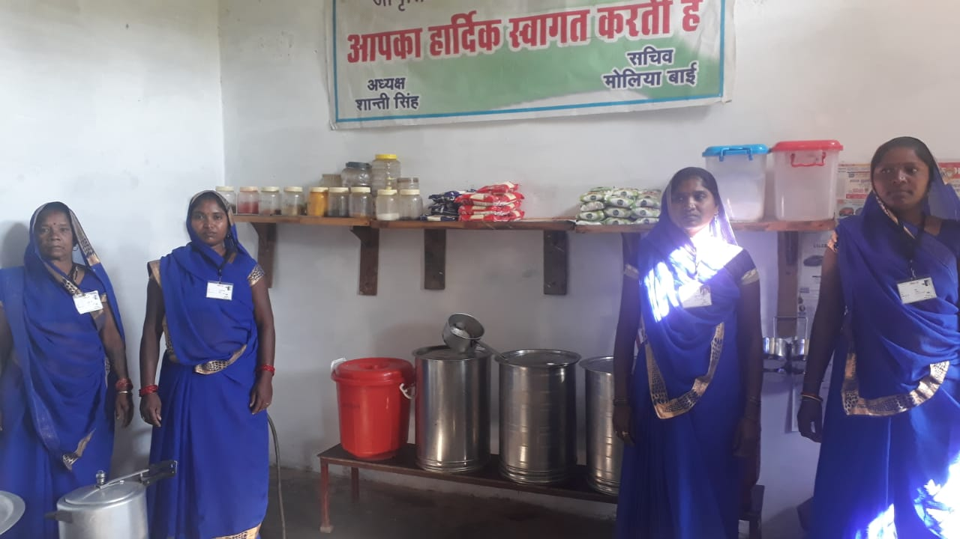
Cook Cum Helpers
Government of Madhya Pradesh
District – Vidisha and Chhindwara

Slide 13
Honorarium of Cook-Cum-Helper
(April 2019 to Dec. 2019)
Government of Madhya Pradesh
(In Cr)

Slide 14
Transportation Assistance - Utilization
(April 2019 to Dec. 2019)
Government of Madhya Pradesh
(In Cr)

Slide 15
MME- Utilization
(April 2019 to Dec, 2019)
Government of Madhya Pradesh
(In Cr)

Slide 16
Government of Madhya Pradesh
Kitchen Cum Store

Slide 17
Government of Madhya Pradesh
Repair of Kitchen Cum Store

Slide 18
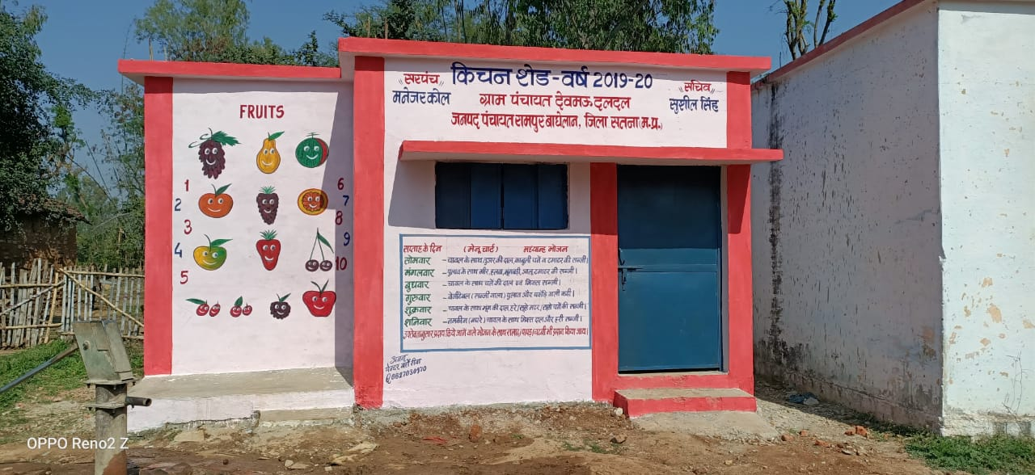
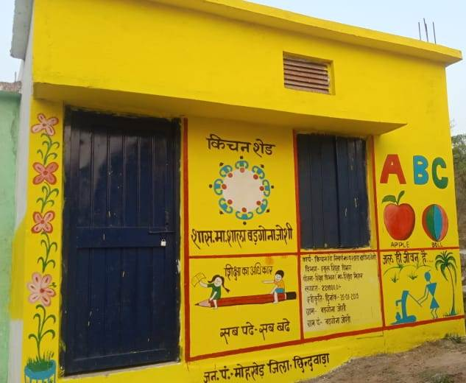
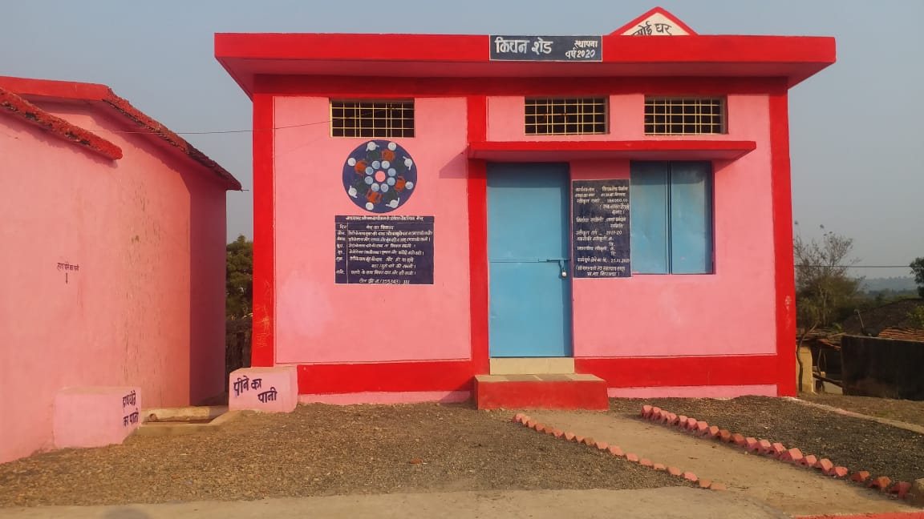
Kitchen shed
Government of Madhya Pradesh
District –Satna

Slide 19
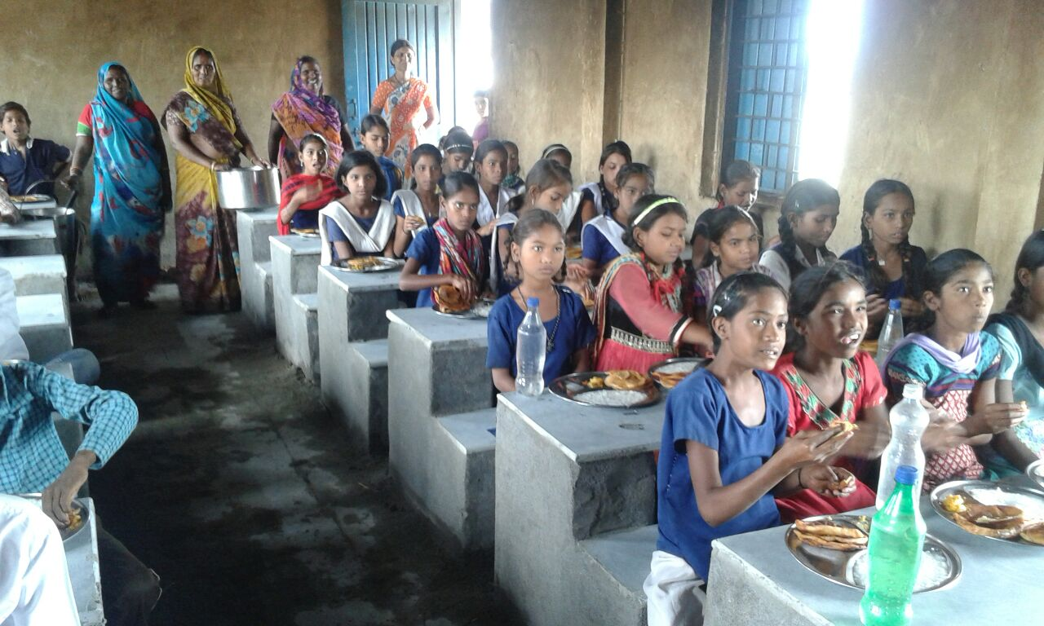
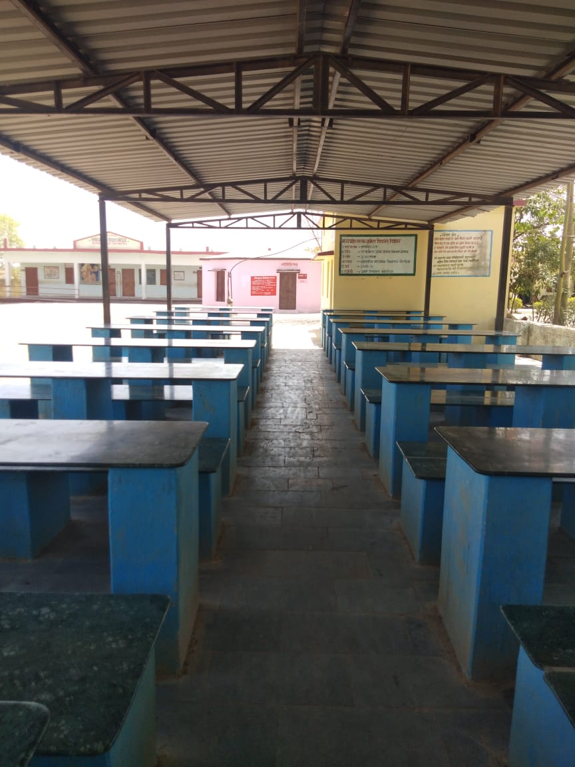
Dining hall
Government of Madhya Pradesh
Built under Panch-parmeshwar scheme
District –Neemuch

Slide 20
Annual and Monthly Data Entry for F.Y. 2019-20
Government of Madhya Pradesh
Annual MIS
Monthly MIS

Slide 21
Government of Madhya Pradesh
Automated Monitoring System has been operationalised
51 districts have successfully ported their data on mdmhp.nic.in portal.
Currently 18903 Schools of 51 districts have sent reports through app, sms in Feb 2020
MDM Scheme is being implemented through http://mdm.mp.gov.in MDM Portal.

Slide 22
Government of Madhya Pradesh
State MDM Portal
The MDM Scheme is being implemented through MDM Portal created with the help of NIC, Bhopal
Cooking cost to SHG and honorarium to CCH is being electronically transferred to their respective bank accounts
Food grain is being allotted to SHG’s /Agencies through eRO. Food grain is calculated school wise and sent to the government fair price shops (PDS) mapped with the concerned schools through NAN Portal

Slide 23
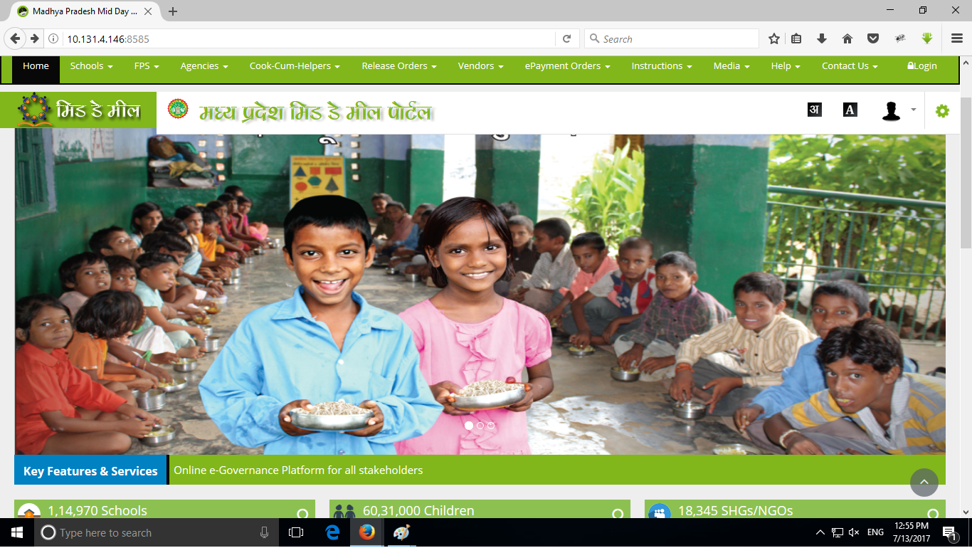
Government of Madhya Pradesh
State MDM Portal
Website - http://mdm.mp.gov.in

Slide 24
Proposal for the year 2020-21
Government of Madhya Pradesh

Slide 25
Number of Schools
Government of Madhya Pradesh

Slide 26
Coverage of Students
Working Days

Slide 27
Government of Madhya Pradesh
Requirement of Food Grain (In Mts)
Requirement of Cost of Food Grain (In Lakhs)

Slide 28
Government of Madhya Pradesh
Requirement of Cooking Cost (In Lakhs)
Requirement of Transportation Assistance (In Lakhs)

Slide 29
Requirement of CCH and their Honorarium
Government of Madhya Pradesh

Slide 30
Government of Madhya Pradesh
Requirement of Kitchen Cum Store

Slide 31
Government of Madhya Pradesh
Requirement of Kitchen Cum Store Repair

Slide 32
Government of Madhya Pradesh
Requirement of Kitchen Devices & Replacement

Slide 33
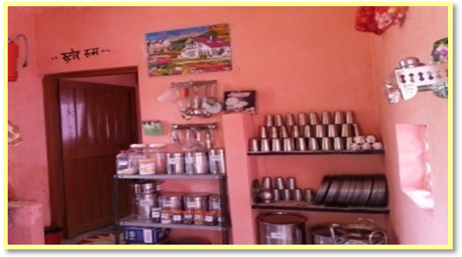
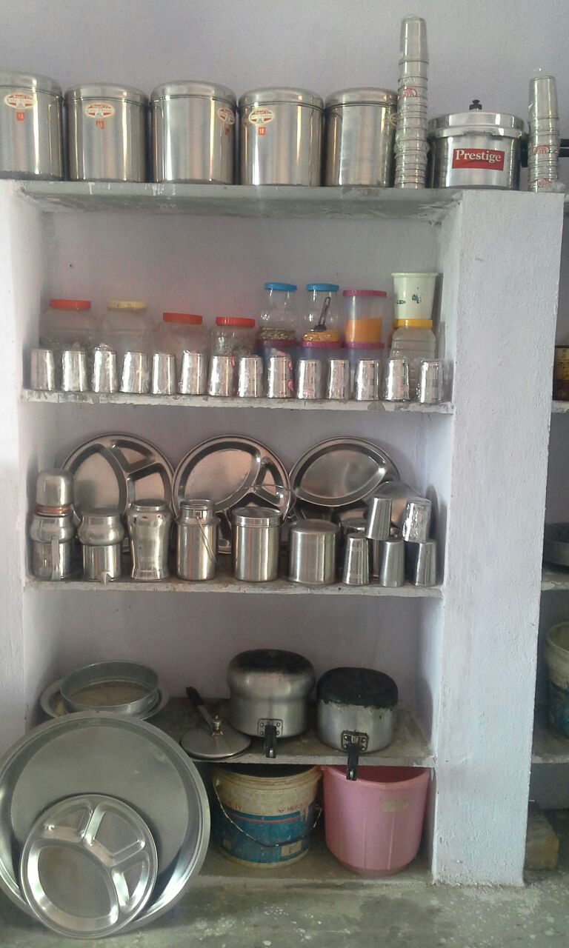
Kitchen Devices
Government of Madhya Pradesh
District -Chhindwara

Slide 34
Proposal For 2020-21
(Primary & Upper Primary)
Government of Madhya Pradesh
(In Lakh)

Slide 35
Flexi fund
Government of Madhya Pradesh
Allocation of 2019-20 Rs. 51.25 Cr
Expenditure of SNGs (9976 ) Rs. 4.99 Cr
Available Balance (Not Received) Rs. 46.26 Cr
Year 2020-21 Expected Allocation Rs. 51.00 Cr
Proposed activities
    Nutrition Kitchen Gardens (9012 unit) - 4.51 Cr
    Additional Nutrition of Malnourished and Tribal 139 blocks, enrolled 1881543 primary students .
    Distribution of Chikki made out of ground nut and jaggery by NRLM compliant SHGs .
    Total Expenditure - 46.26 Cr (2019-20) + 35.46 Cr = 81.72 Cr
    Covied-19 Kit for 2.18 Lakh CCH
    2 Apron, 2 Cap, 20 Cotan Mask , 20 Sope for per CCH in 1 Year
    Total Amount - 14.78 Cr.

Slide 36
Flexi fund
Government of Madhya Pradesh
Distribution of Chikki

Slide 37
Flexi fund
Government of Madhya Pradesh
SNGs and Covied-19 Kit for CCH

Slide 38
Kitchen Garden
Government of Madhya Pradesh

Slide 39
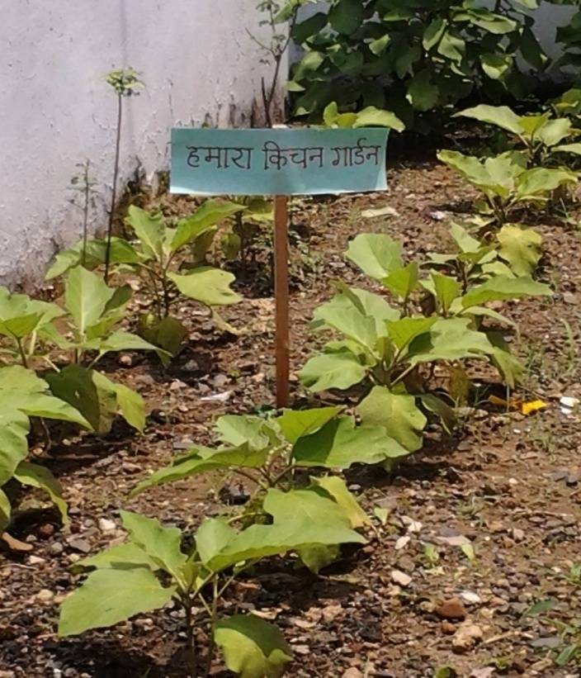
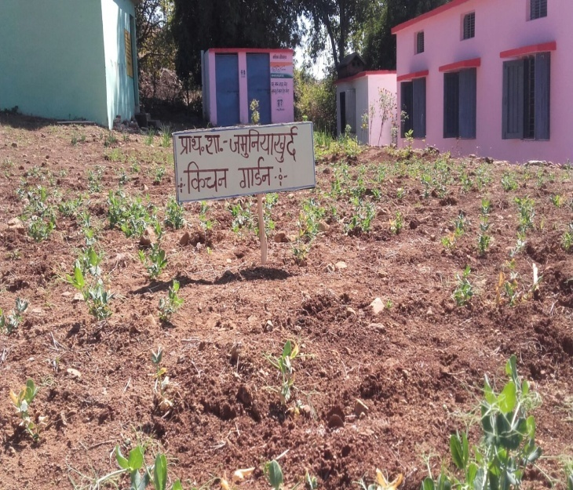
Kitchen Garden in School
Government of Madhya Pradesh
District - Chhindwara

Slide 40
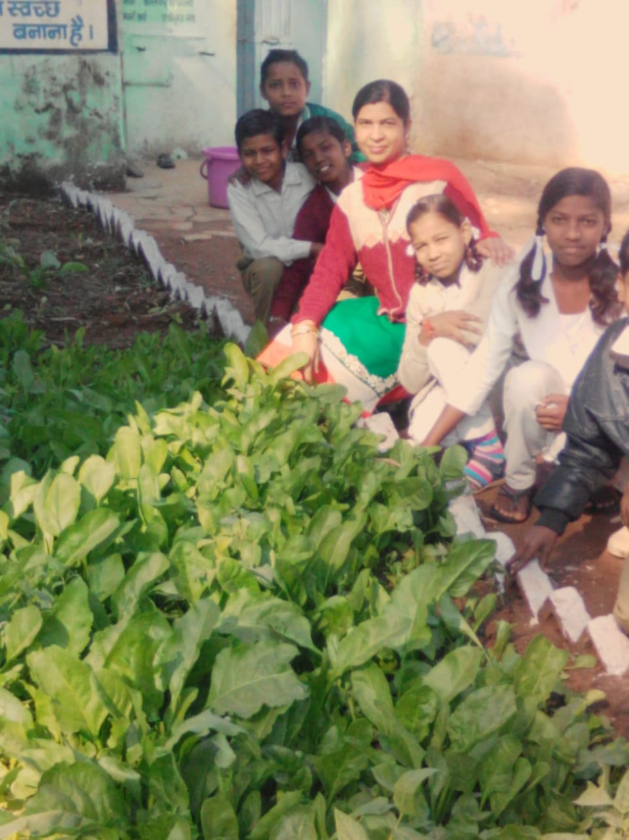
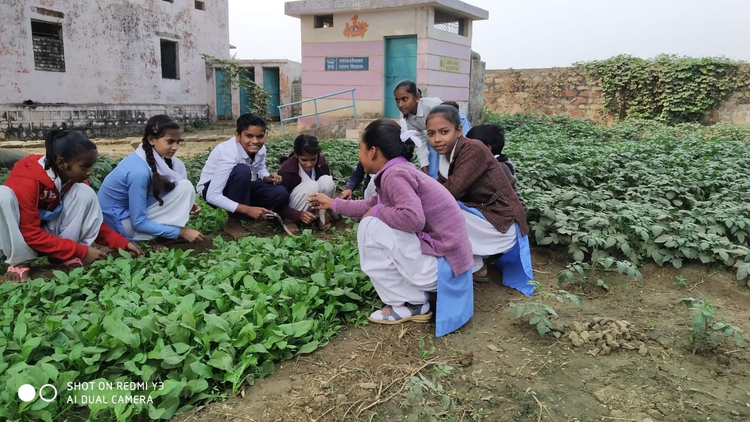
Kitchen Garden in School
Government of Madhya Pradesh
District – Balaghat and Vidisha

Slide 41
LPG GAS CONNECTION
Government of Madhya Pradesh

Slide 42
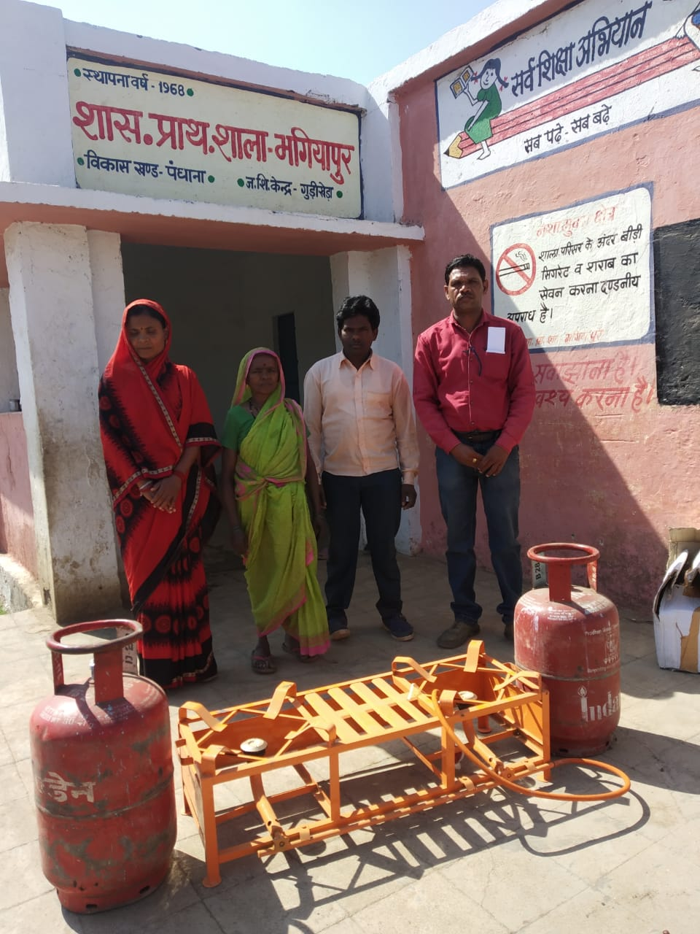
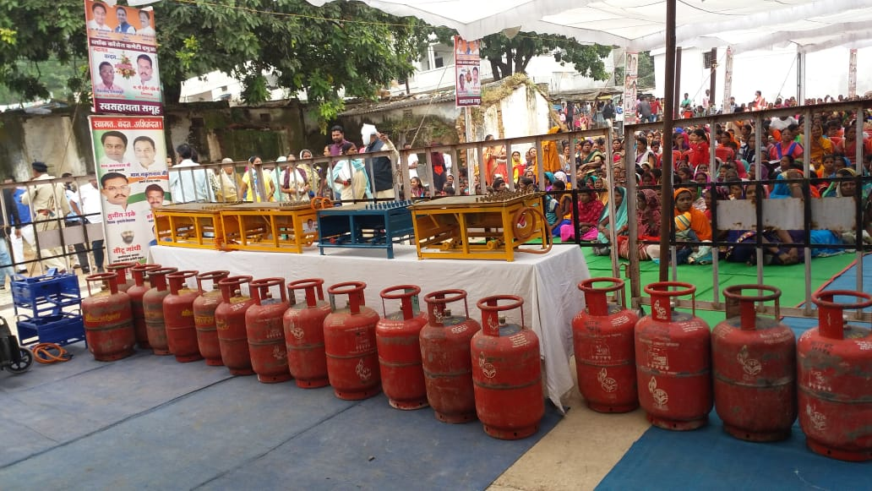
LPG GAS CONNECTION DISTRIBUTION
Government of Madhya Pradesh
District - Khandwa

Slide 43
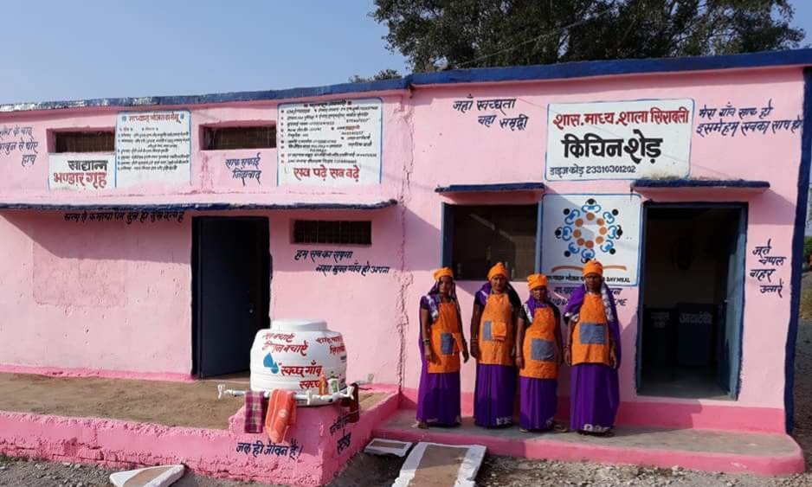
Clean Kitchen Competition
Government of Madhya Pradesh
At the district level, three awards have been given in Clean Kitchen Competition.
First prize – Rs. 50000/- Second prize – Rs.30000/- Third prize - Rs. 20000/-
District - Vidisha

Slide 44
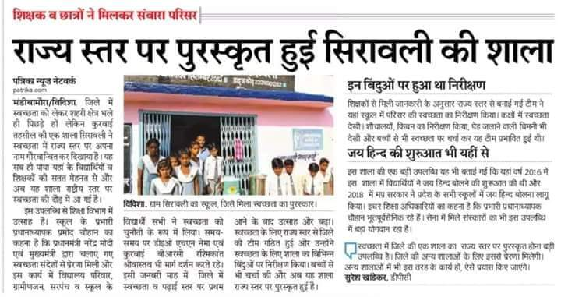
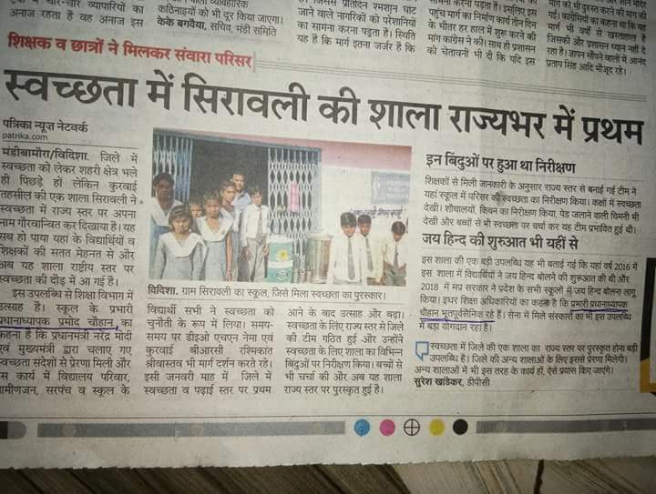
Clean Kitchen Competition
Government of Madhya Pradesh

Slide 45
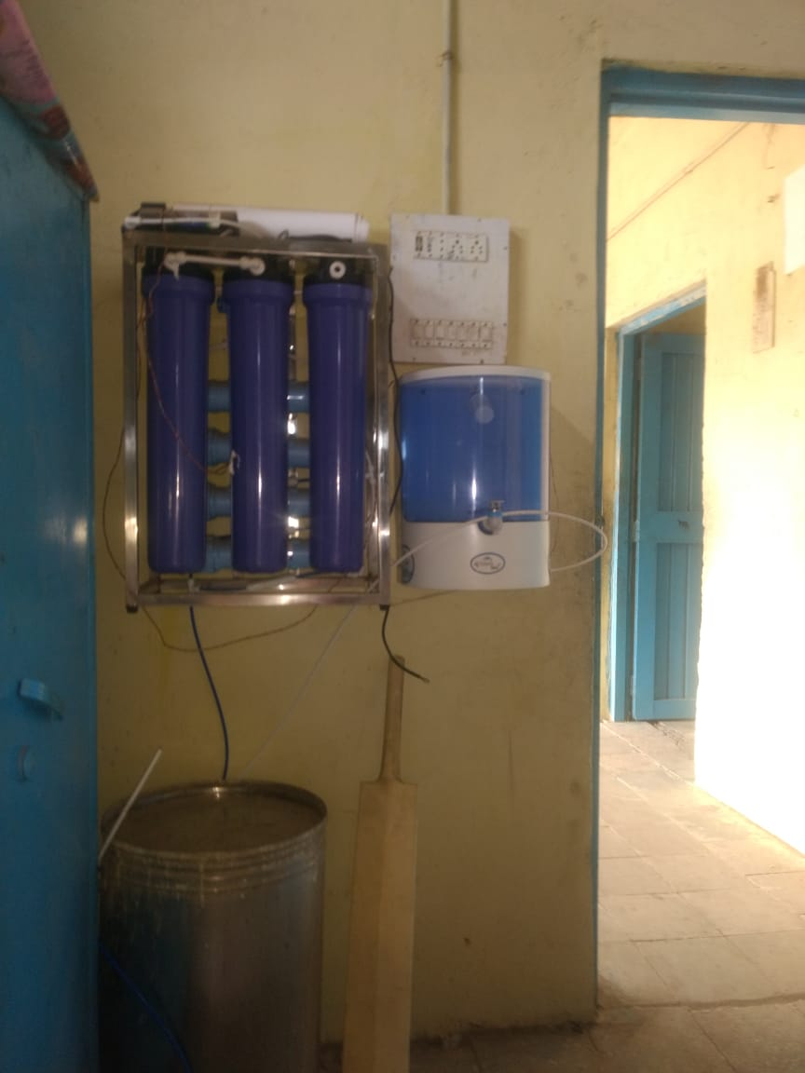
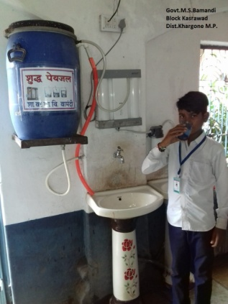
Drinking Water
Government of Madhya Pradesh
District – Sagar and Khargone

Slide 46
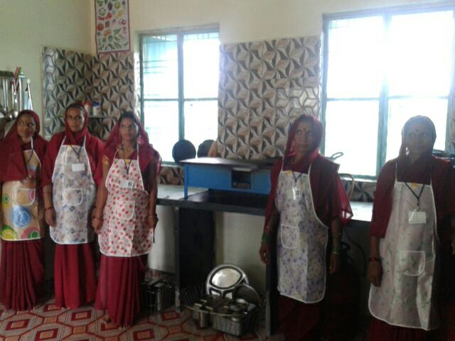
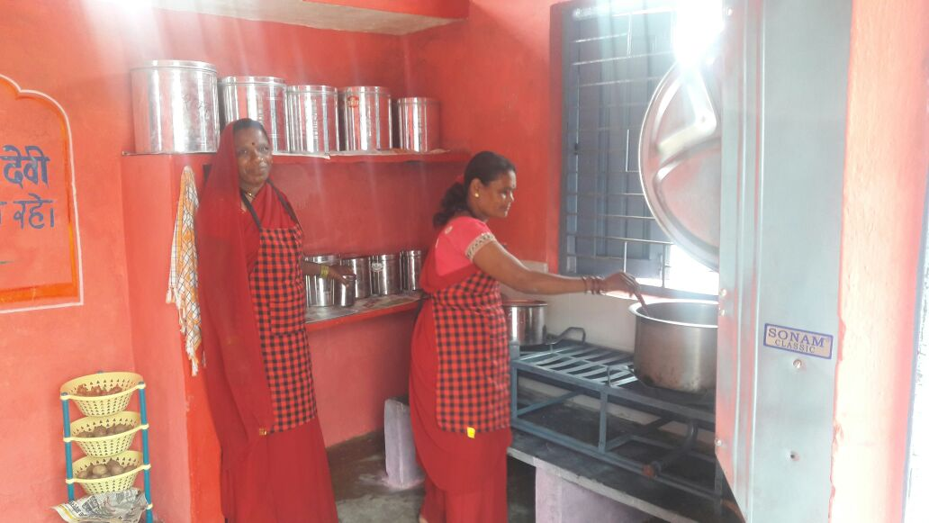
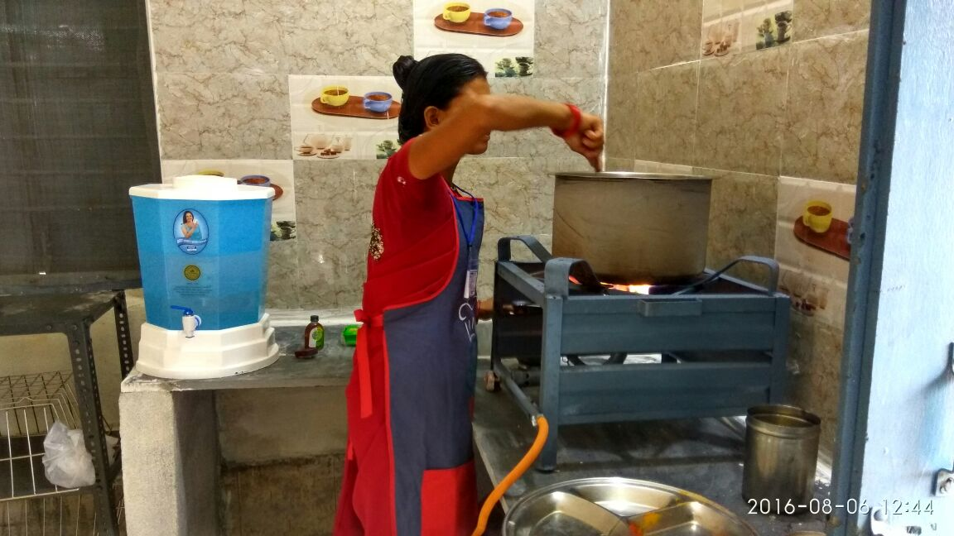
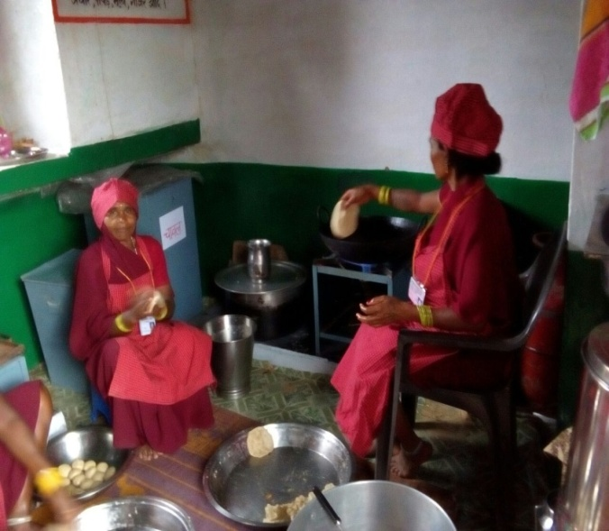
Making food
Government of Madhya Pradesh
District – Chhindwara and Harda

Slide 47
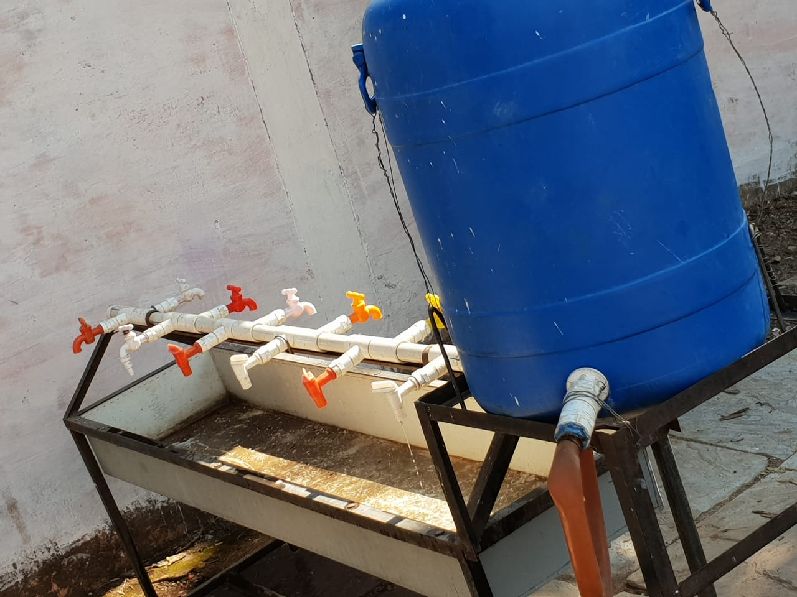
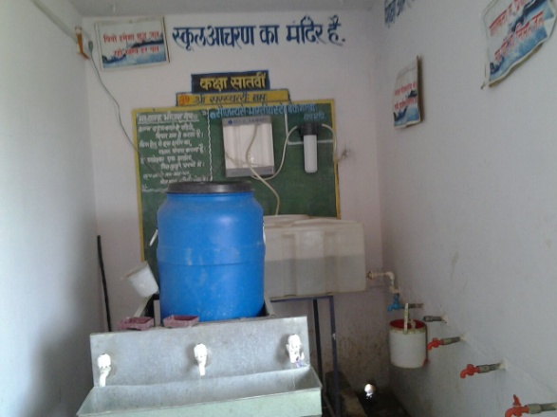
Multi tap Hand wash Unit
Government of Madhya Pradesh

Slide 48
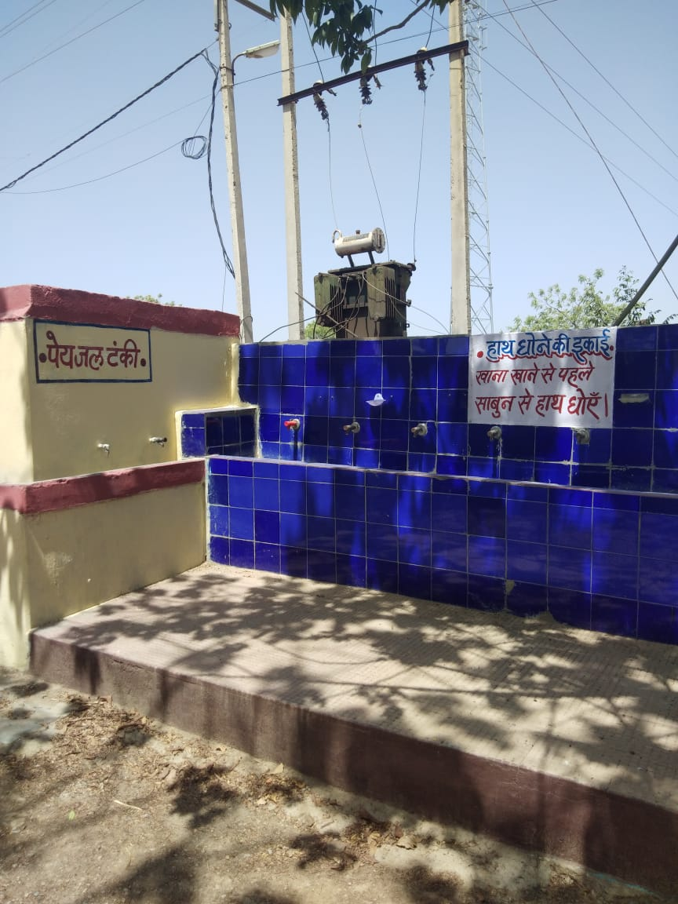
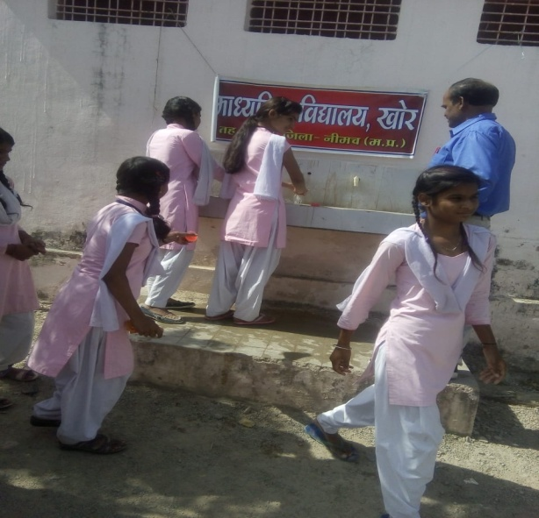
Multi tap Hand wash Unit
Government of Madhya Pradesh
District- Neemuch

Slide 49
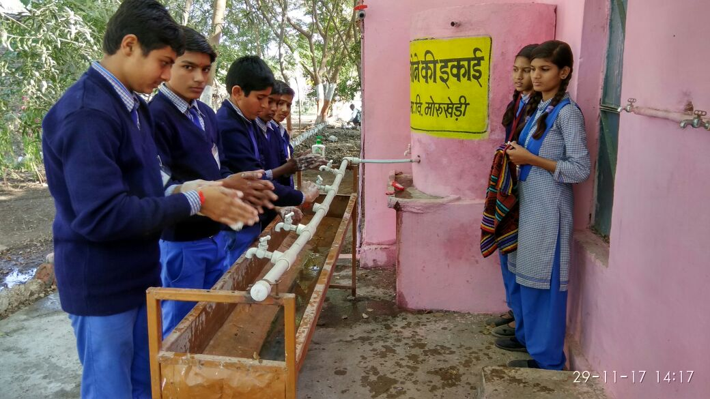
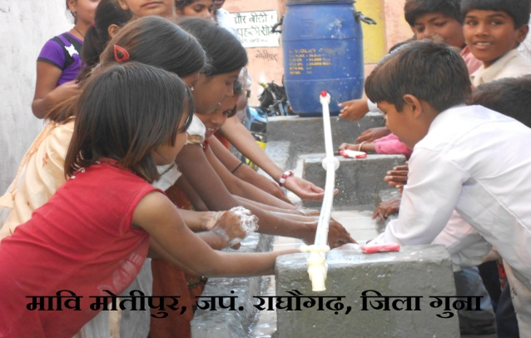
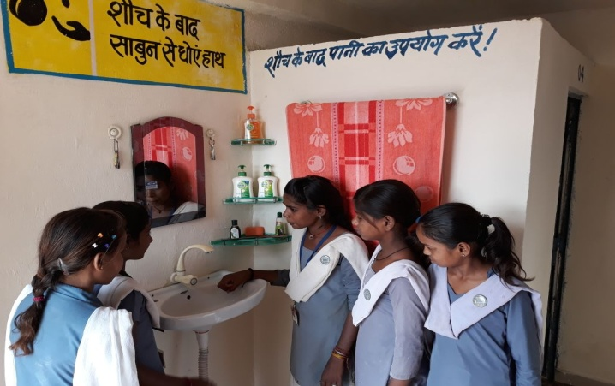
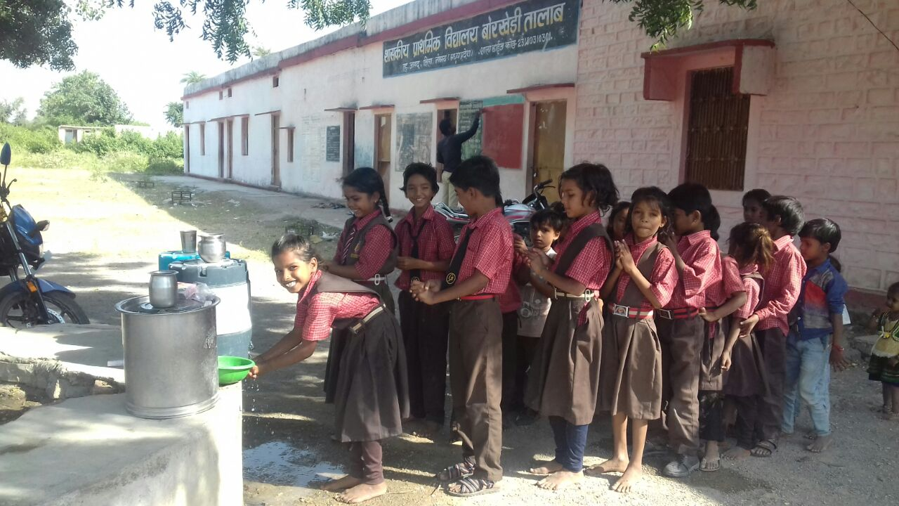
Handwash
Government of Madhya Pradesh
District – Guna, Neemuch and Vidisha

Slide 50
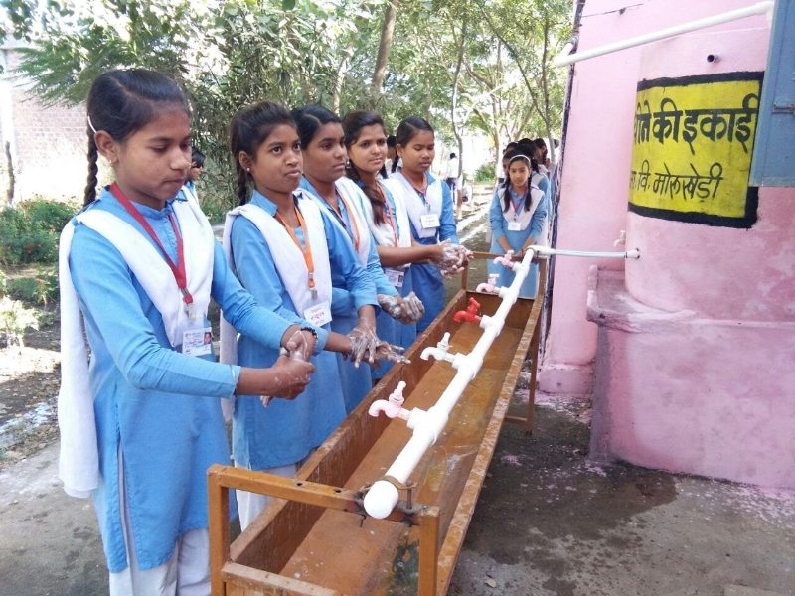
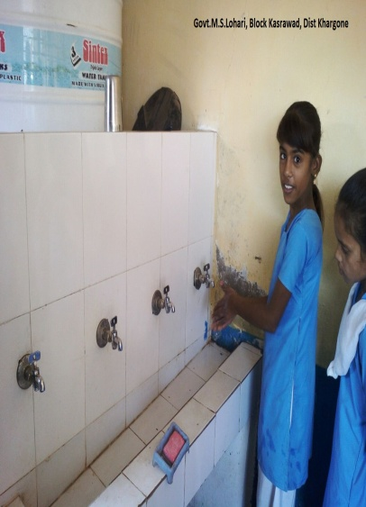
Handwash
Government of Madhya Pradesh
District – Dewas and khargone

Slide 51
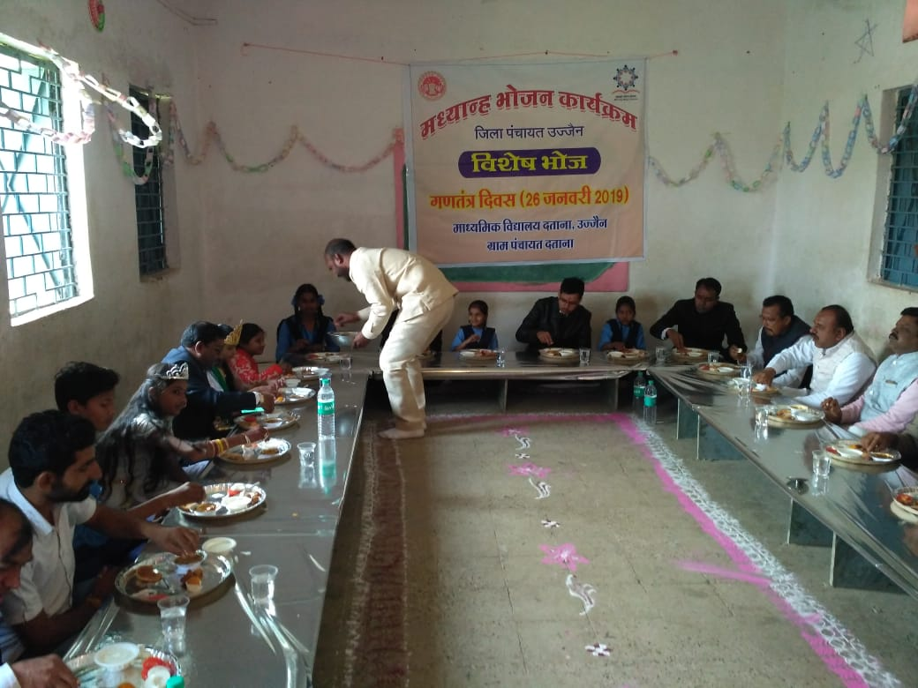
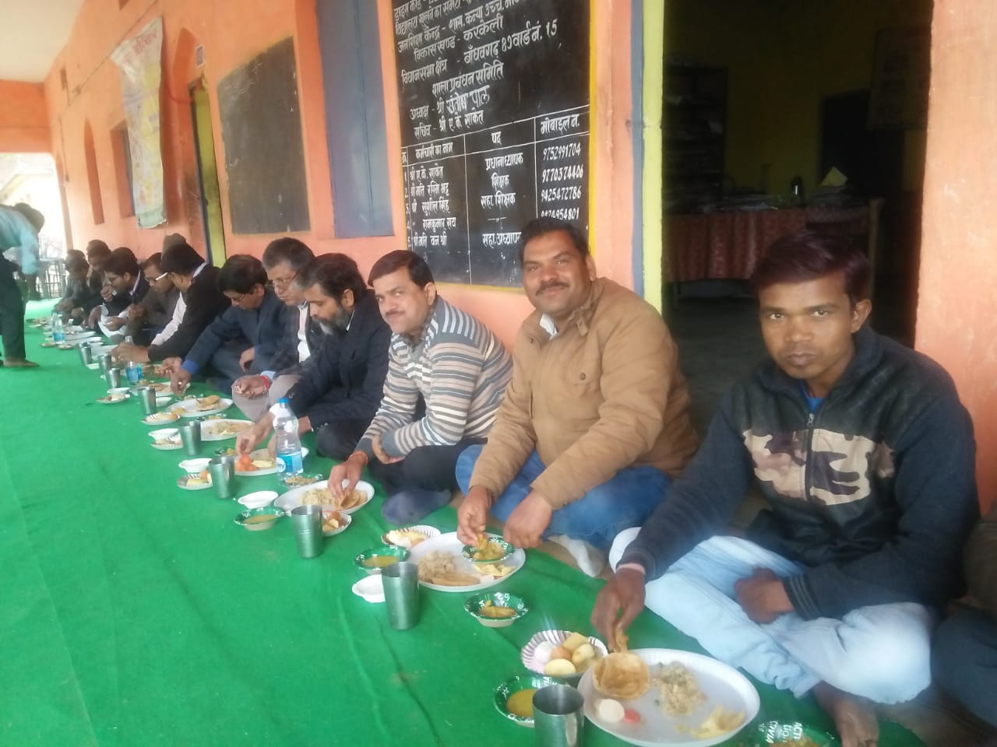
Sneh Bhoj
Government of Madhya Pradesh
District –Ujjain

Slide 52
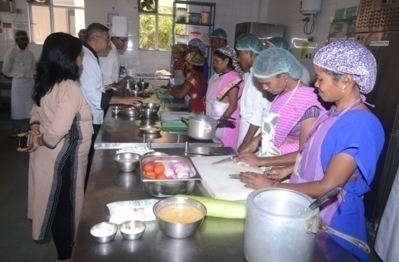
Training of Cook cum helpers
District- Chhindwara

Slide 53
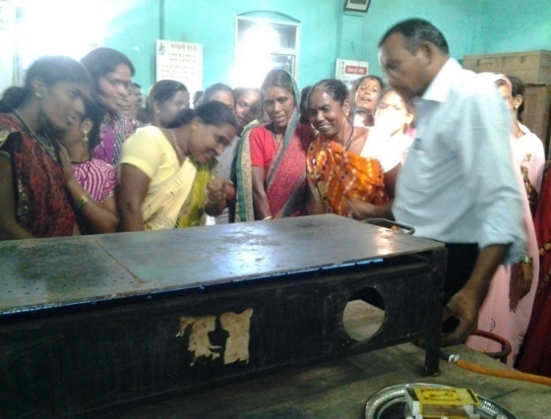
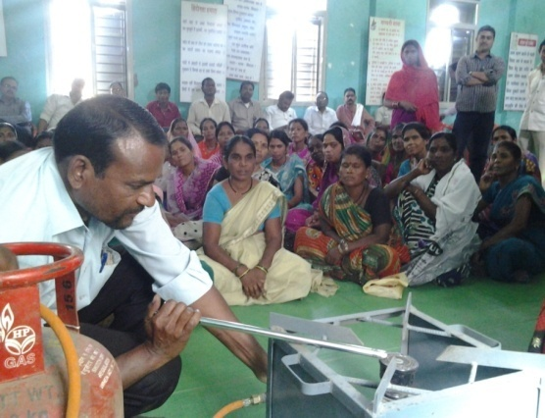
Training of Cook cum helpers
Government of Madhya Pradesh
District- Chhindwara

Slide 54
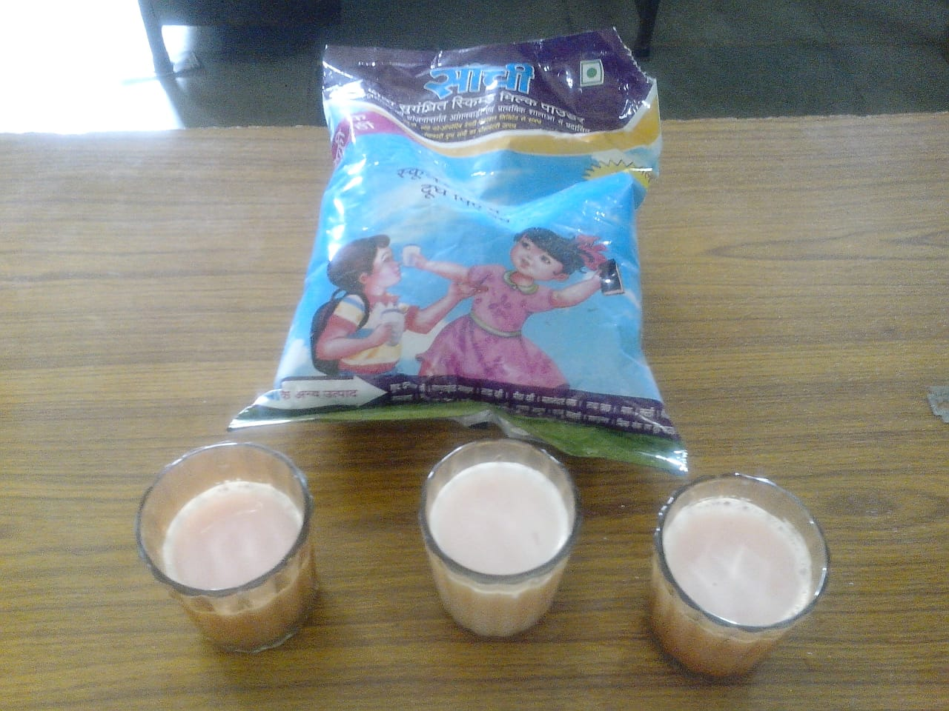
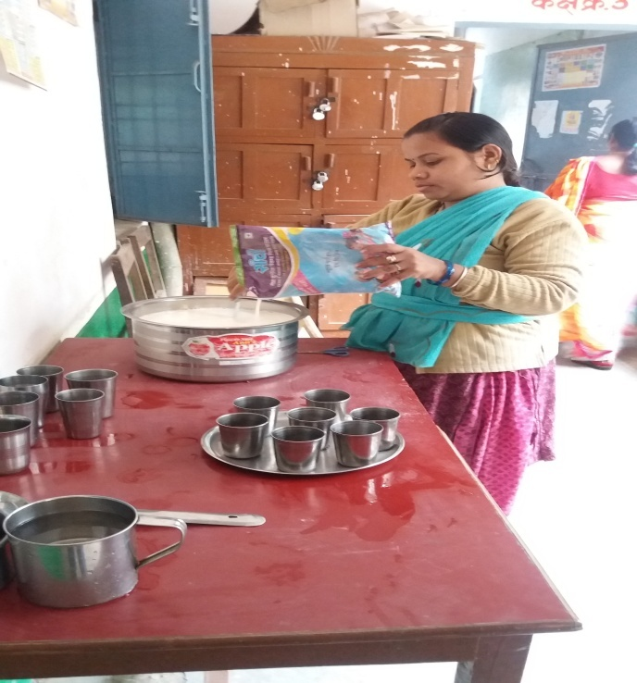
Milk Distribution
Government of Madhya Pradesh
From 15.07.2015 milk is being served to students of Primary schools and Anganwadis three times a weak (Monday, Wednesday and Friday).
100 ml warm liquid milk prepared out of 10 gm milk powder.
District - Khargone

Slide 55
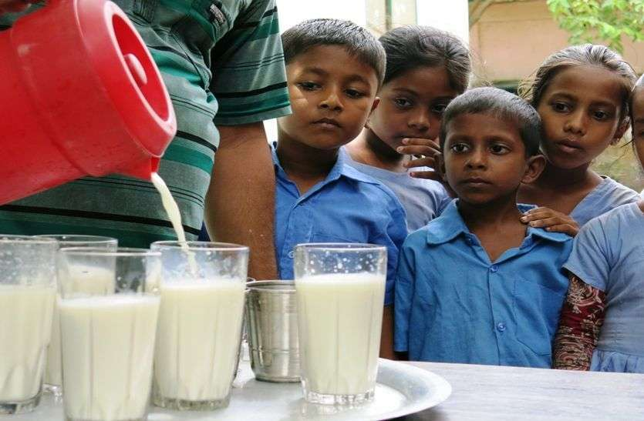
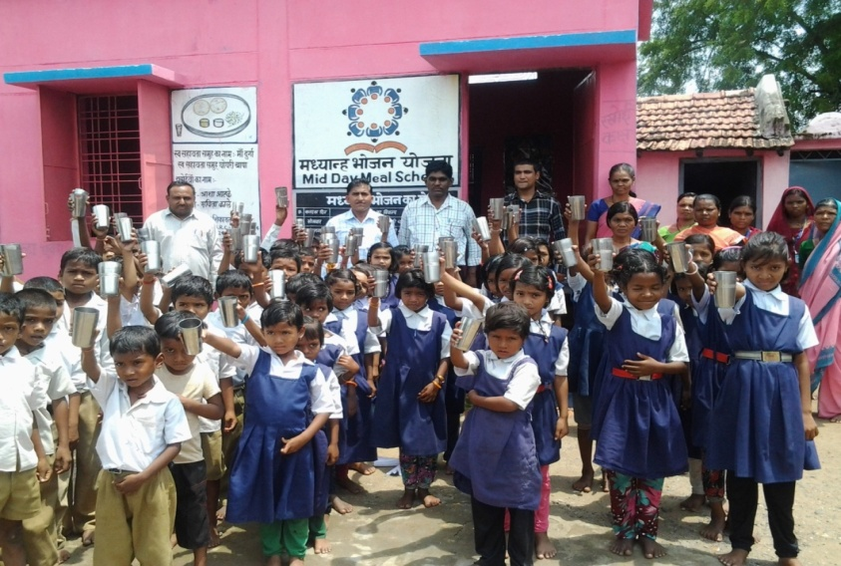
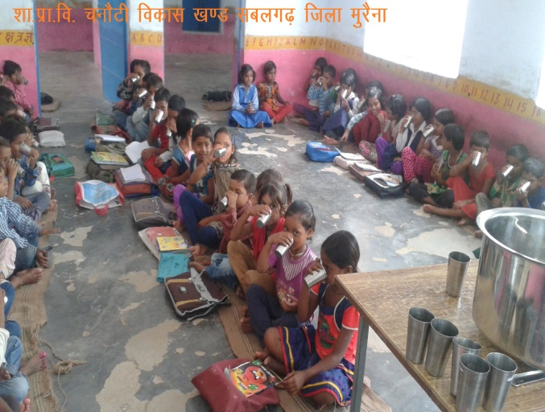
Milk Distribution
Government of Madhya Pradesh
District – Morena, Mandla and Dhar

Slide 56

Health Checkup
Government of Madhya Pradesh
District -Mandla

Slide 57


Health Checkup
Government of Madhya Pradesh
District -Dewas

Slide 58

Health Checkup
Government of Madhya Pradesh
District -Mandla

Slide 59
Emergency Medical Plan / Contingency plan
Government of Madhya Pradesh
3-Member committee (SDM, CDPO, BRC’s)
Committee will inspect the place within 3 hours and send the report within 24 hours
District Magistrate
Send the report to Head Office, Bhopal within 24 Hrs
State Coordinator (MDM)

Slide 60


Government of Madhya Pradesh
First Aid Box
.
District : Jabalpur

Slide 61


Government of Madhya Pradesh
Covid – 19
.
Distribution of Food Security Allowance in lockdown period
March and April 2020 – 33 Days
Total Enrollment – 66.27 Lakh
Total Cooking Cost – 117.11 Cr.
Total Food grain - – 26159.79 MT
Distribution of food grains from door to door to children

Slide 62



Government of Madhya Pradesh
Covid – 19
The Food Security Allowance was released through a single click by the HCM MP.
.

Slide 63


Government of Madhya Pradesh
Covid – 19
.
Distribution of Food Security Allowance in lockdown period

Slide 64


Government of Madhya Pradesh
Covid – 19
.
Distribution of Food Security Allowance in Summer Vacation period
May and June 2020 – 37 Days
Total Enrollment – 66.27 Lakh
Total Cooking Cost – 145.92 Cr.
Total Food grain – 29479.65 MT
Food is being distributed to the children from house to house.

Slide 65
Thank You
Government of Madhya Pradesh

